Slide 1
Optimizing Spring Enrollment for Spring Enrollment Data Entry
Presented by
PTD Technology
3001 Coolidge Road Suite 403
East Lansing, MI 48823

Slide 2
What’s New This Spring?
Remember:
Spring Enrollment due to CEPD Administrators June 24th, 2021.
EMC/Dual Enrollment and work-based learning is also due at this time.
Preliminary credentials due June 24th; Final credentials due August 31st.
Students need to be enrolled in classes by May 14th so OCTE can match records to the MSDS.
Reports ➔ Building Exports can help you review enrollments.
Attempt to maximize the number of Completers and Concentrators your programs produce:
Concentrators: Have completed at least 8 segments (2.0 grade or higher).
Completers: Have completed all 12 segments (2.0 grade or higher).

Slide 3
Spring Enrollment Data Collection
Spring Enrollment data determines how funds will be distributed next year.
What do I need to verify?
CTE course sections are entered accurately.
Teachers are properly assigned to classes.
Students have valid UICs.
Students are enrolled in the correct courses and will receive the segments they need.
Credentials are linked to students correctly.
Work based learning experiences are recorded.

Slide 4
Optimizing Spring Enrollment
CTEIS includes many tools and features to assist with data entry and verification.
We will review entry of:
Courses
Students
Enrollments
Importing data
Reports that will help you verify your entries

Slide 5
Help Is Available
Technical Help
For technical questions regarding data collection
If you need assistance with importing or entering data
For any issues relating to CTEIS operations or usage
PTD Help Desk
cteis.help@PTDtechnology.com
(800) 203-0614 or (517) 333-9363
Ext. 128
Policy Help
For direct questions regarding OCTE policy issues
Joan Church
ChurchJ@michigan.gov
(517) 335-0360

Slide 6
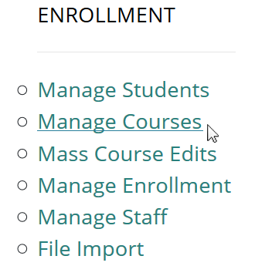
Manage Courses
Use an instructional design form when entering courses.
Building reporters are never responsible for determining class details or segment information.
Look for the Data Entry link.
Click on Manage Courses.
Here you may:
Add a new course section
Edit individual course sections
Copy course information

Slide 7
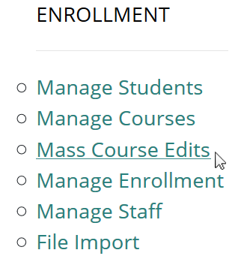
Mass Course Edits
Mass Course Edits allow you to update multiple records simultaneously.
Go to Data Entry, then Mass Course Edits.
The fields you may mass edit include:
Beginning and ending dates
Semester
Virtual delivery mode
High school credits earned
College credits earned
You may also Mass Deactivate courses using this feature.

Slide 8
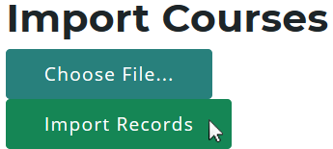
Import Courses
CTEIS allows you to import course details from a Student Management System.
Go to Data Entry, then Student/Course/Enr. Import.
Select the building you wish to import course information into.
Beneath Import Courses, click the “Choose File…” link:
Browse for your import file.
Click the “Import Records” button.
Review import information and click “Add Courses” when ready.

Slide 9
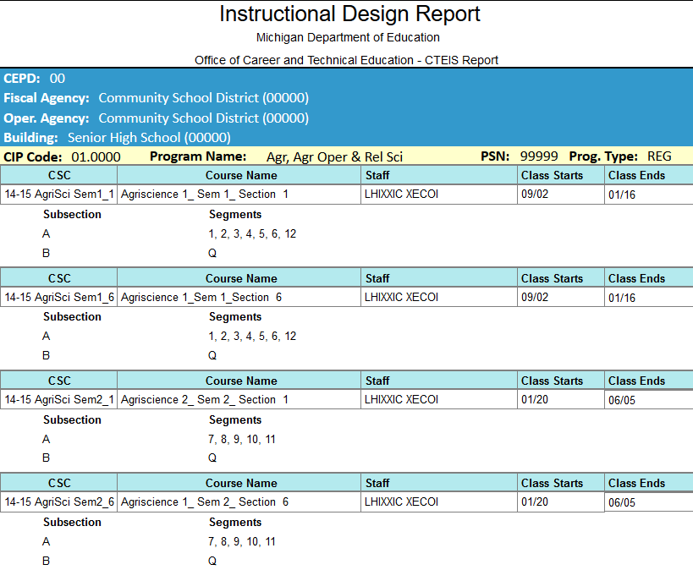
Review Courses
Instructional Design Reports
Show the courses operating during a selected year.
Go to Reports, then Building Reports.
Under Program / Course Reports.
Use this report to verify:
That your classes have been
entered into CTEIS accurately for the current year.
That your courses offer the 12 segments required for your programs to produce completers.

Slide 10
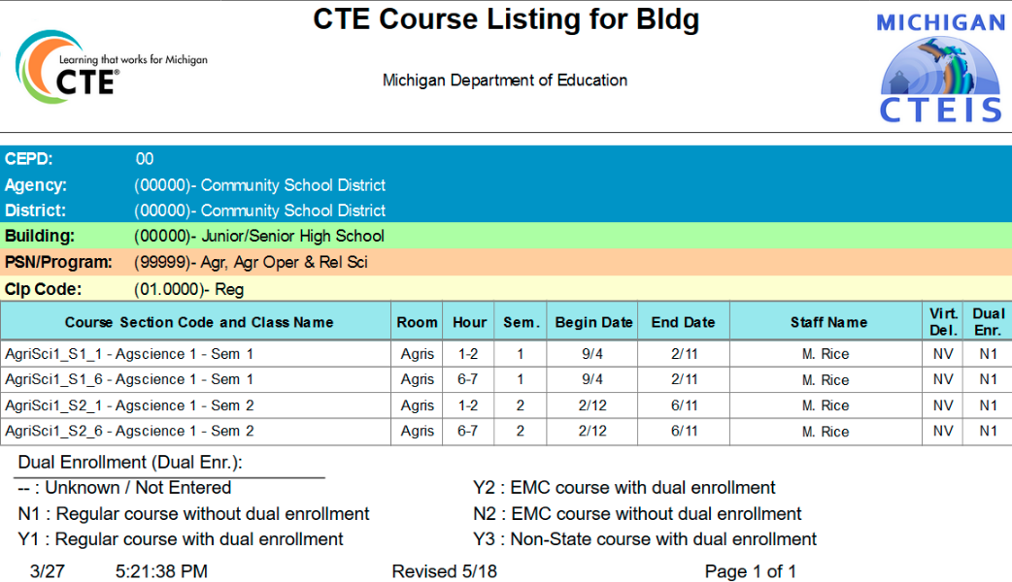
Review Courses
List of Courses by Building Report
Shows all courses operating during the current school year within a selected building.
Go to Reports, then Building Reports.
Under Program / Course Reports.
Use this report to verify:
That your classes within a building (or PSN) have been entered into CTEIS accurately for the current year.
That your course detail fields are accurate.

Slide 11
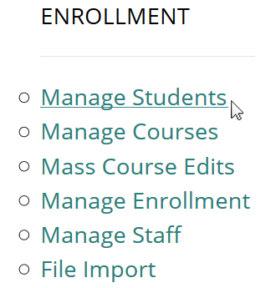
Manage Students
It is extremely important that this information is entered correctly as it is used to:
Update MSDS supplemental data.
Allow Follow-Up reporters to contact students.
Go to Data Entry, then Manage Students.
From this screen, you may:
Add new student records
Edit / Review pre-existing student records
View student enrollment history and segment profiles

Slide 12
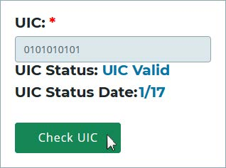
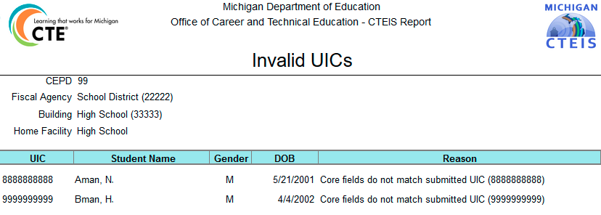
Review Students
Check UIC Button
Allows you to verify student UICs without saving records.
Bad UIC by Building Report
Shows the UIC, student name, gender, date of birth, and UIC errors of all enrolled students within a building.
Go to Reports, then Building Reports.
Under Audit Reports.
Use this report to:
Locate and print students who do not pass the 4483 validation check.

Slide 13
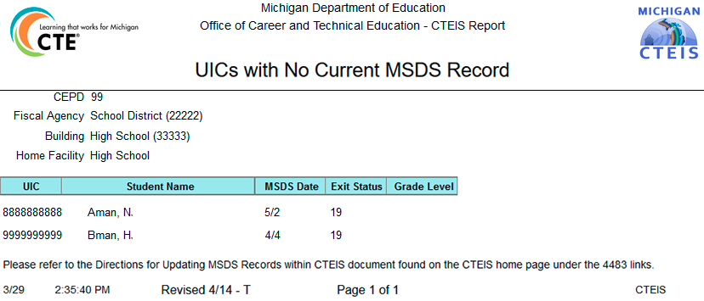
Review Students
Expired MSDS Check Date Report
Displays a list of students who have not been updated within the MSDS.
Go to Reports, then Building Reports.
Under Audit Reports.
Use this report to verify:
That all student core fields match the records within the MSDS.

Slide 14
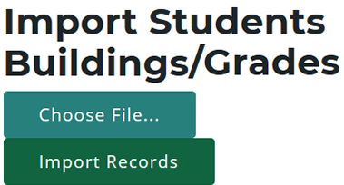
Import Students
CTEIS allows you to import student demographic details from a Student Management System.
Go to Data Entry, then Student/Course/Enr. Import.
Select the building you wish to import student information into.
Beneath Import Students/ Buildings/ Grades, click the “Choose File…” link:
Browse for your import file.
Click the “Import Records” button.
Review import information and click “Process Students / Enrollments” when ready.

Slide 15
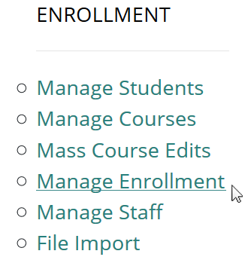
Manage Enrollment
CTEIS offers a variety of tools to help you manage your student enrollments.
Go to Data Entry, then Manage Enrollment.
Here you may take a variety of actions:
Enroll students in courses
Edit student enrollment information
Copy / transfer enrolled students from one class to another
Print a class list
Input student grades
Check the segments students are enrolled in

Slide 16
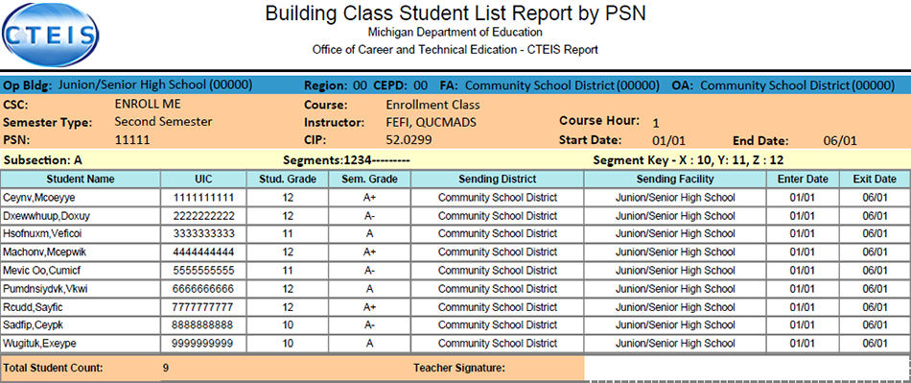
Review Enrollment
Class Student List Report
Contains segment information, grades, and student enter and exit dates for courses operating within a selected building.
Go to Reports, then Building Reports.
Under Audit Reports.
Use this report to obtain teacher sign-off and verify:
That your students have been enrolled into the correct courses for the current year.
That your courses offer the 12 segments required for your students to become completers.

Slide 17
Review Enrollment
Program Enrollment History Report
Displays the historical information of all students enrolled within a selected program.
Includes segment profiles.
Go to Reports, then
Building Reports.
Under Program / Student Reports.
Use this report to verify that:
Your students have been enrolled into the correct courses for the current year.
Your courses offer the 12 segments required for your students to become completers.

Slide 18
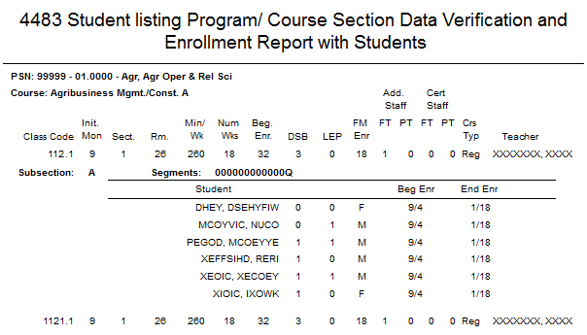
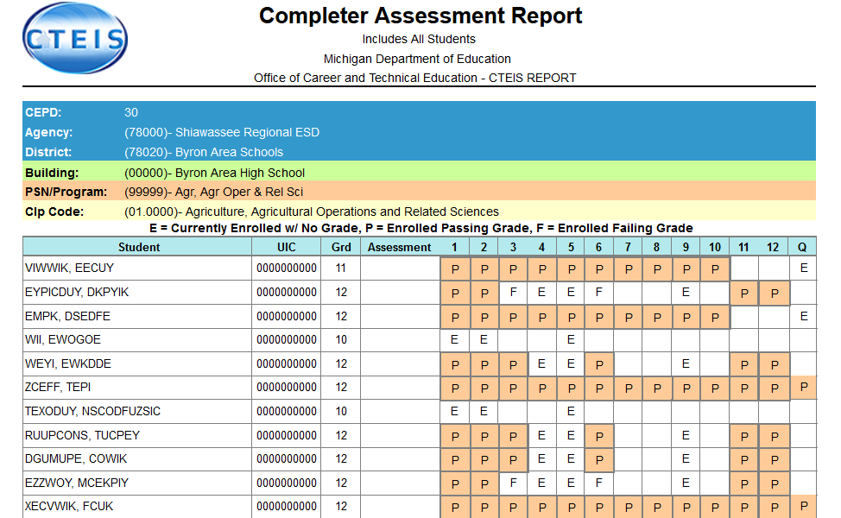
Validate Enrollment Data
Run validation early and frequently to alert yourself to student data issues that may take time to resolve, and to also gain access to helpful reports.
Go to Data Entry ➔ Enrollment Completion.
The 4483 Rpt and 4483 Std buttons provide a summary of enrollment counts.
The CompA button lists the segments students have completed or are expected to earn credit for.
These reports can help you determine:
That your student enrollment information was entered properly.
Which students will become Concentrators or Completers at the end of the year.

Slide 19
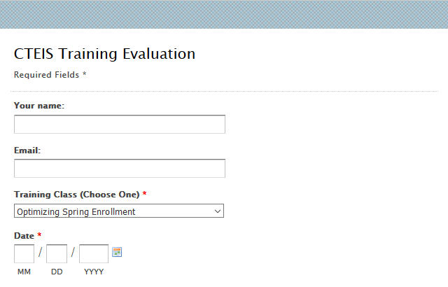
Questions?
Thank you!
Don’t forget to fill out our Training Evaluation Form at
support.cteis.com

