Slide 1
CTEIS Responsibilities of the Level 5 Fiscal Agency Authorized Official
Presented by
PTD Technology
3001 Coolidge Road
Suite 403
East Lansing, MI 48823

Slide 2
Introduction
OCTE appoints two FAs for each Fiscal Agency district.
What are my responsibilities?
Oversee all Operating Building reporting activities.
Grant CTEIS reporting roles and permissions to all users (including CEPD Administrators).
Review program data.
Submit CTE reports to the CEPD Administrator.

Slide 3
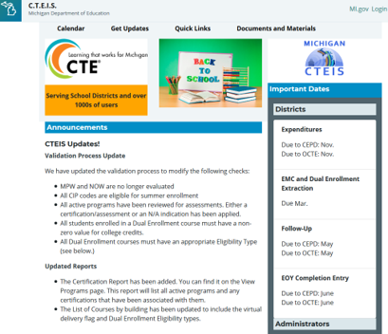
CTEIS Updates
Join the CTEIS Listserv for continual updates: e-mail MartinezJ9@michigan.gov
Fall Data Entry: building reporters must enter courses and instructors into CTEIS by October 31, 2020.
The New Programs Application is moving to the Grant Electronic Management System (GEMS).
The due date is still TBD.
New Work-Based Learning guides and training schedules will be published in the near future.

Slide 4
Help Is Available
Technical Help
For technical questions regarding data collection
If you need assistance with importing or entering data
For any issues relating to CTEIS operations or usage
PTD Help Desk
cteis.help@PTDtechnology.com
(800) 203-0614 or (517) 333-9363
Ext. 128
Policy Help
For direct questions regarding OCTE policy issues
Joan Church
ChurchJ@michigan.gov
(517) 335-0360

Slide 5
Timeline of Events
September | Manage new users. Begin coordinating Expenditure personnel. Begin coordinating Follow-Up personnel. Begin coordinating Enrollment personnel and assisting with proper instructional design of classes.
October | Class and staff enrollment data deadline (Oct. 31, 2020).
November | Expenditures report submission (Nov. 5, 2020 – Nov. 12, 2020). Oversee Work-Based Learning and post-secondary credential collection.
January | Follow-Up report submission (Jan. 8, 2021 – Jan. 15, 2021).
March/April | Oversee UIC/MSDS data review and maintenance.
May | Student enrollment data deadline (May 14, 2021).
June | Enrollment report submission (June 17, 2021 – June 24, 2021).
*Oversight and Coordination of Building Reporters:
September – November: Expenditures reporting; Enrollment instructional design.
October – January: Follow-Up reporting.
November – June: Enrollment reporting.

Slide 6
Fall Tasks —September
Managing Users in CTEIS
FAs should assist reporters and CEPD Administrators with CTEIS accounts before fall training starts. You can:
Adjust CTEIS permissions.
Add new CTEIS users.
Coordinating Expenditure and Enrollment Data Entry
FAs are strongly encouraged to inform reporters of training events and prepare to answer questions:
District expenditures
Student enrollments

Slide 7
Fall Tasks —September - October
Coordinating Follow-Up Data Entry
CEPD Administrators receive packet materials at the end of September.
Make sure your reporters:
Review Follow-Up materials.
Prepare for training events in October.
Class and Staff Enrollment Data Deadline
All CTE courses and linked staff members must be entered into CTEIS by October 31, 2020.
Prepare to answer questions regarding fall data entry.

Slide 8
Fall Tasks —November
Expenditures Data Review and Submission
November 5 - 12, 2020.
Go to Admin ➔ Fiscal Agent Monitoring ➔ Expenditure Fiscal Agency Review.
Oversee Work-Based Learning and Post-Secondary Credential Collection
Processes for collecting Work-Based Learning information are still under development.
Contact OCTE with questions.

Slide 9
Winter Tasks —January
Follow-Up Data Review and Submission
January 8 - 15, 2021.
Go to Admin ➔ Fiscal Agent Monitoring ➔ District Follow-Up Review.
Review Survey % on Survey Results report.
Should be as close to 100% as possible.

Slide 10
Spring Tasks —March/April
March 12, 2021
Final EMC and Dual Enrollment data entry deadline.
Students must be enrolled in correct classes and include valid UICs.
UIC/MSDS Data Review
Prepare for the mid-May Enrollment deadline.
Student enrollments must include valid UICs.
Building reporters may want to use CTEIS reports to assist with identifying problematic UICs:
Bad UIC Report
UIC with No MSDS

Slide 11
Spring Tasks —May
Student Enrollment Data Deadline
May 14, 2021
All CTE students must be enrolled in at least one course section and have correct UICs so that they may be counted for funding.

Slide 12
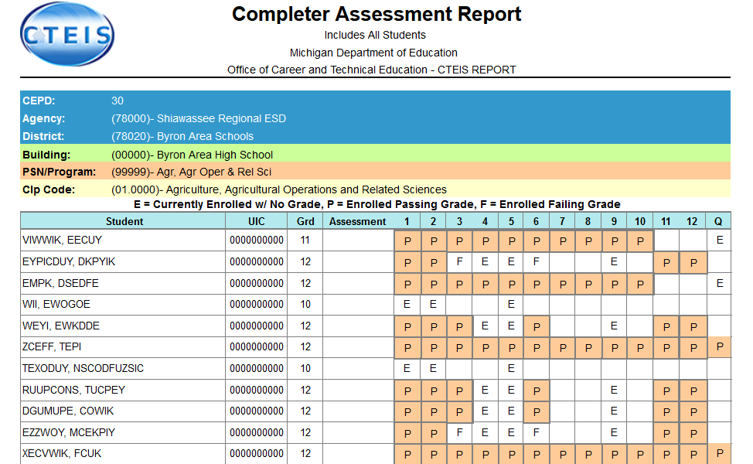
Spring Tasks —June
Enrollment Data Review and Submission
June 17 - 24, 2021.
Go to Admin ➔ Fiscal Agent Monitoring ➔ Enrollment Collection Submission.
The Report and Repstd buttons provide a summary of enrollment counts.
The CompA button lists the segments students have completed or are expected to earn credit for.
These reports can help determine:
That your student enrollment information was entered properly.
Which students are progressing toward concentrator/completer status.

Slide 13
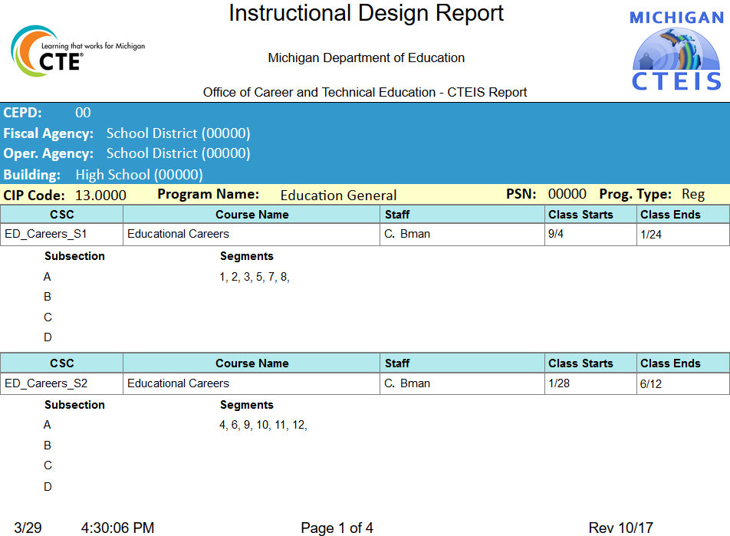
Reports for Reviewing Courses
Instructional Design Reports
Show the courses operating during a selected year.
Allows for easy viewing of program segment information.
Go to Reports, then Building Reports.
Under Program / Course Reports.
Use these reports to verify:
That classes have been
entered into CTEIS accurately for the current year.
That courses offer the 12 segments required for your programs to produce completers.

Slide 14
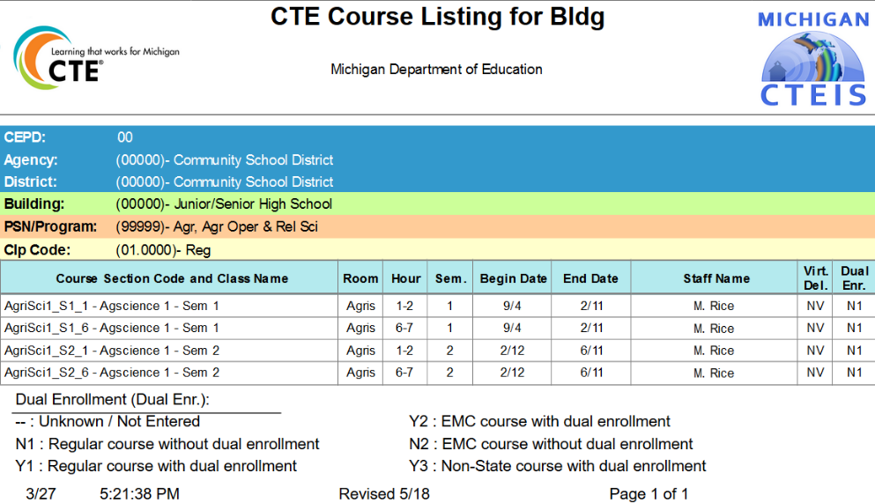
Reports for Reviewing Courses
List of Courses by Building Report
Shows all courses operating during the current school year within a selected building.
Go to Reports, then Building Reports.
Under Program / Course Reports.
Use these reports to verify:
That classes within a building (or PSN) have been entered into CTEIS accurately for the current year.
That course detail fields are accurate.

Slide 15
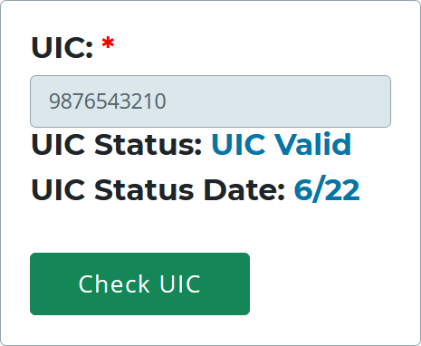
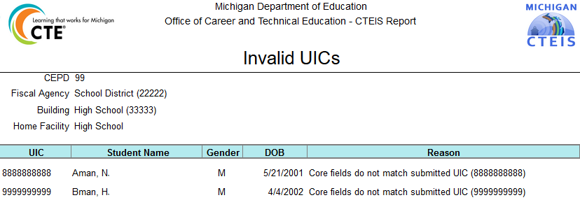
Reports for Reviewing Students
Check UIC Button
Allows your reporters to verify student UICs without saving records.
Bad UIC by Building Report
Shows the UIC, student name, gender, date of birth, and UIC errors of all enrolled students within a building.
Go to Reports, then Building Reports.
Under Audit Reports.
Use this report to:
Locate and print students who do not pass the enrollment validation check.

Slide 16
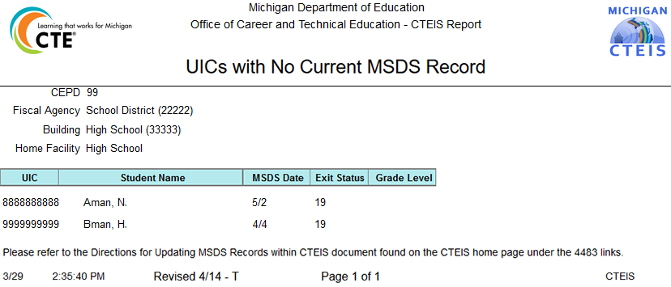
Reports for Reviewing Students
UIC With No Current MSDS Report
Displays a list of students with invalid UICs.
Go to Reports, then Building Reports.
Under Audit Reports.
Use this report to verify:
That all student core fields match the records within the MSDS.

Slide 17
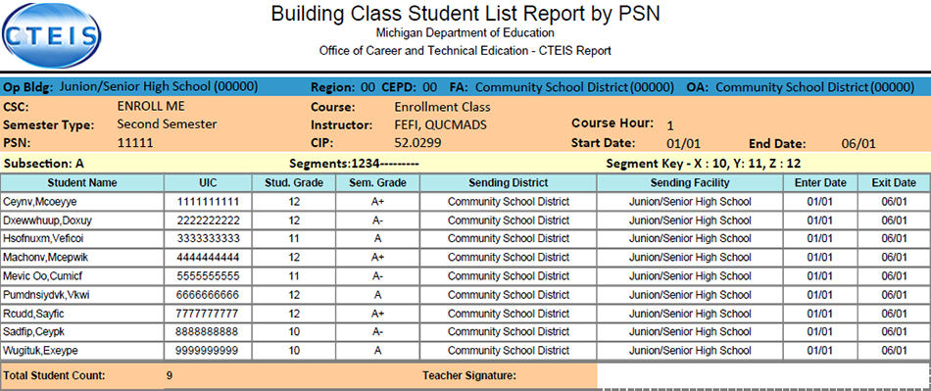
Reports for Reviewing Enrollment
Class Student List Report
Contains segment information, grades, and student enter and exit dates for courses operating within a selected building.
Go to Reports, then Building Reports.
Under Audit Reports.
Use these reports to verify:
That students have been enrolled into the correct courses for the current year.
That courses offer the 12 segments required for students to become completers.

Slide 18
Reports for Reviewing Enrollment
Program Enrollment History Report
Displays the historical information of all students enrolled within a selected program.
Includes segment profiles and previous assessment scores.
Go to Reports, then
Building Reports.
Under Program / Student Reports.
Use these reports to verify that:
Students have been enrolled into the correct courses for the current year.
Courses offer the 12 segments required for students to become completers.

Slide 19
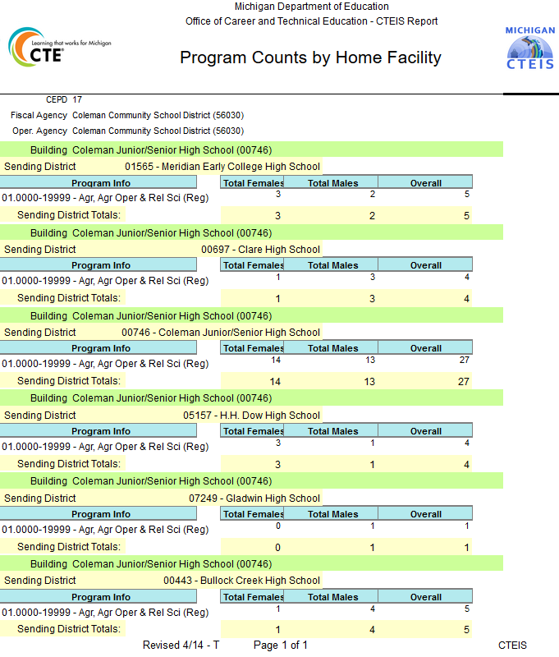
Reports for Reviewing Enrollment
Program Counts Report
Shows how many students have been enrolled into each program within the selected building(s).
Go to Reports, then Building Reports.
Under Program / Student; Audit Reports.
Use these reports to verify:
That classes have been entered into CTEIS accurately for the current year.
That courses contain the correct number of student enrollments.

Slide 20
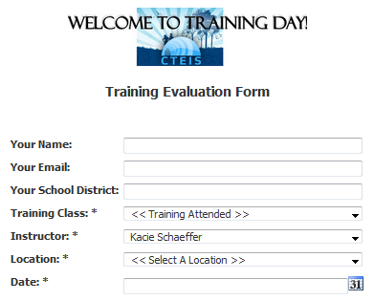
Questions?
Thank you!
Don’t forget to fill out our Training Evaluation Form on the wiki at
Training and General Info ➔
CTEIS Training Evaluation

