Slide 1
CTEIS Expenditures
Presented by
PTD Technology
3001 Coolidge Road
Suite 403
East Lansing, MI 48823
Notes:
Welcome
My name is Doug Wiesner, I am the Project Manager with PTD Tech on the CTEIS Project
Talk about Reporting on your CTEIS Expenditures
If hve any questions please put in chat and mark as questions.
This is primarily for Building reportings
Will go over some info for FA and CTEIS

Slide 2
What Is the Expenditures Report?
Used to document funds spent in support of state-approved CTE programs.
Section 61a(1), 61b, 61c CTE Added Cost funds spent.
Other funds spent – generally local funds; excludes Perkins funding.
Why Is This Report Important?
Ensures funds are properly spent supporting CTE programs
Captures the true cost of CTE programming.
Data is used annually to calculate Added Cost Factors for each CIP Code.
Required by legislation

Slide 3
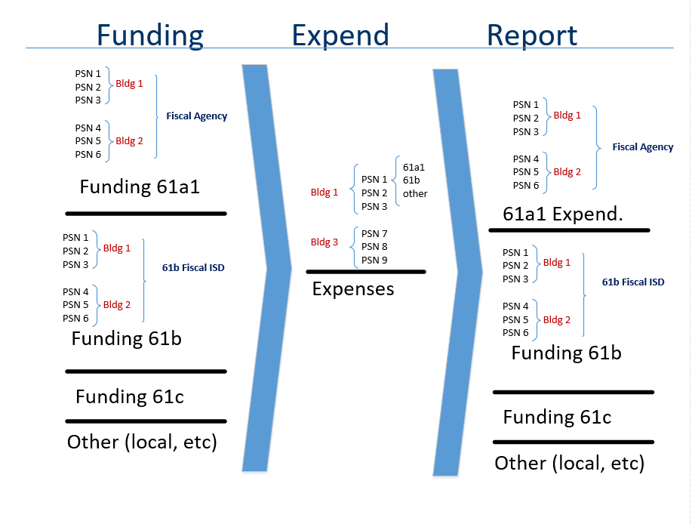
Expenditures

Slide 4
Report All Expenditures
Meet the requirement to expend funds
61a1 funds must match your 61a1 Expenditures
Totaled at the Fiscal Agency level
61b funds must match your 61b Expenditures
Totaled at the 61b Fiscal ISD Level
Required Expenditures (75% of the added cost of the program)
Program Improvement Requirement – 90%
Program Cost Determination
Feeds back into the funding formula

Slide 5
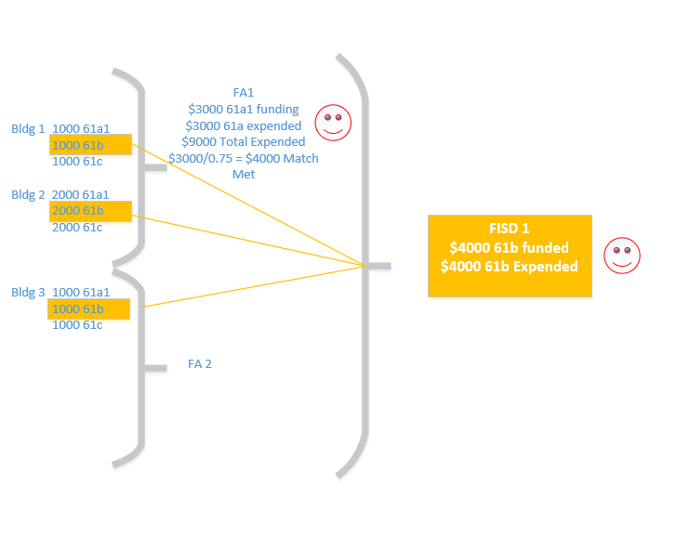
61a1 and 61b Matches

Slide 6
Support
Technical Help
I pushed a button, and nothing happened!
Why am I getting this error message?
PTD Help Desk
cteis.help@PTDtechnology.com
(800) 203-0614 or (517) 333-9363
Ext. 128
Policy Help
Where do I find my info?
How do I report a credit?
Joan Church
ChurchJ@michigan.gov
(517) 335-0360
OCTE Website: http://www.michigan.gov/octe

Slide 7
OCTE Expenditures Guidance Workbooks
Located on the CTEIS Knowledge Base: support.cteis.com/Data-Entry/Expenditures
Allowable expenditures.
Function/object code categories and descriptions.
Program improvement items.

Slide 8
Logging In
Make sure you have a MILogin Account:
No longer using MEIS
https://milogintp.michigan.gov/
If have old MEIS, link to MiLogin
Your Fiscal Agency Authorized Official (Level 5 Official) will authorize your MILogin account for CTEIS.
Navigate to MiloginTP (https://milogintp.michigan.gov/) (or train.cteis.com).
Enter your Milogin username and Password.
Make sure your Level 5 Official has given you access to the Data Entry menu and the Expenditures module.

Slide 9
The 4-Step Process
Collect expenditure information from appropriate personnel.
Enter expenditure records.
Enter Manually
Create distribution tables (optional).
Import
Run expenditures validation.
Submit your final Expenditures Report.

Slide 10
What Information Do I Report?
Expenditures should be reported only for state-approved CTE programs for which enrollments were reported.
How do I know they are approved?
The classes contained enrolled students.
The enrollments were reported on the Spring Enrollment Report.
The programs appear within your Expenditures grid.
Expenditures are reported for individual programs within each of your buildings.

Slide 11
Collecting Expenditure Information
Typically collected from the Business / Finance Office.
Contact tables may be helpful!
Example in manual (Appendix: Contact Table).
Know the Following:
Amount of expenditure you are reporting.
PSN (building/CIP) for each expenditure.
Function and Object code of the expenditure
Percentage of expenditure to be applied to each PSN (if applied to multiple programs).
Source of Funding (61a1, 61b,61c, other)

Slide 12
Generating a Blank Worksheet
*Tip: To compile worksheets that include each PSN on your report, export your raw data and set up a workbook in Excel.
Click Data Entry  Expenditures  Expenditure Entry.
Select your district and building.
Click Export to Excel, then save your worksheet.

Slide 13
The 4-Step Process
Collect expenditure information from appropriate personnel.
Enter expenditure records.
Enter Manually
Create distribution tables (optional).
Import
Run expenditures validation.
Submit your final Expenditures Report.

Slide 14
Enter Expenditure Records
Select District
Select Building
Select PSN
Select Function/Obj code
Enter funds expended
Make a note
Save

Slide 15
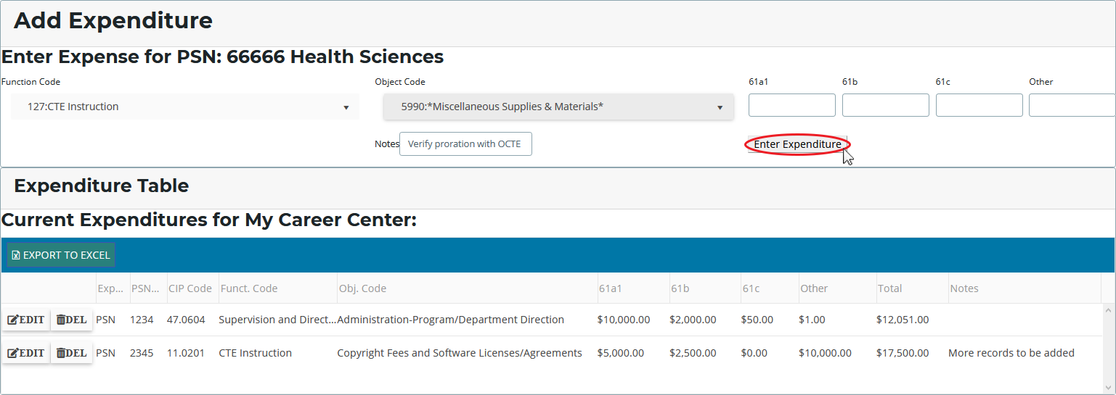
Entering Expenditure Records
Click Data Entry  Expenditures  Expenditure Entry.
Select your district and building.
Click a [$] button to enter program expenditures.
Select a function and object code, then enter the dollars that were applied to the program from each of the four funding sources.

Slide 16
The 4-Step Process
Collect expenditure information from appropriate personnel.
Enter expenditure records.
Enter Manually
Create distribution tables (optional).
Import
Run expenditures validation.
Submit your final Expenditures Report.

Slide 17
Distribution Tables
Allow you to spread the cost of an expenditure across multiple PSNs.
Examples:
Distributing a single teacher’s salary across multiple programs.
“Bundling” travel time to apply to many PSNs.
Claiming maintenance costs for several classrooms.
Distribution Table: “Travel”
PSN | Amount to Report
07703 | 25%
14038 | 25%
17755 | 50%
Click Data Entry  Expenditures  Distribution Tables.
Select your district and building.
Click check boxes to include programs, then name and save the table.
CTEIS will divide expenditure entries in the table across the PSNs included, weighted based on your chosen settings.

Slide 18
The 4-Step Process
Collect expenditure information from appropriate personnel.
Enter expenditure records.
Enter Manually
Create distribution tables (optional).
Import
Run expenditures validation.
Submit your final Expenditures Report.

Slide 19
The 4-Step Process
Collect expenditure information from appropriate personnel.
Enter expenditure records.
Enter Manually
Create distribution tables (optional).
Import
Run expenditures validation.
Submit your final Expenditures Report.

Slide 20
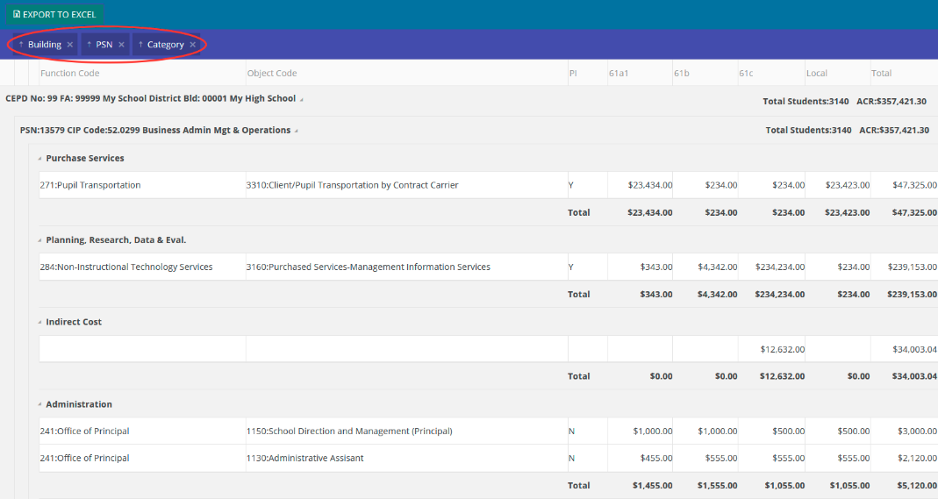
Run Expenditure Validation
Click Data Entry  Expenditures  Expenditure Review.
Select your district.
Click a [VALIDATE] button to review expenditure entries.
Filter your view by:
Removing labels from the header (Building, PSN, Category).
Dragging additional labels to the header row.

Slide 21
Completing Your Report
After all errors are cleared:
The Complete button becomes active.
When a building is marked complete, the system attempts to E-mail your Fiscal Agency Authorized Official.
Follow up by contacting your FA personally.
Export your report to an Excel file.

Slide 22
Submitting Your Report
Reports submitted at the building level are subject to a series of reviews:
Building Level → Fiscal Agent →
CEPD Administrator → OCTE
Directions for Fiscal Agent and CEPD Administrator submissions are on the CTEIS Knowledge Base:
support.cteis.com/Data-Entry/Expenditures

Slide 23
Support
Technical Help
I pushed a button, and nothing happened!
Why am I getting this error message?
PTD Help Desk
cteis.help@PTDtechnology.com
(800) 203-0614 or (517) 333-9363
Ext. 128
Policy Help
Where do I find my info?
How do I report a credit?
Joan Church
ChurchJ@michigan.gov
(517) 335-0360
OCTE Website: http://www.michigan.gov/octe

Slide 24
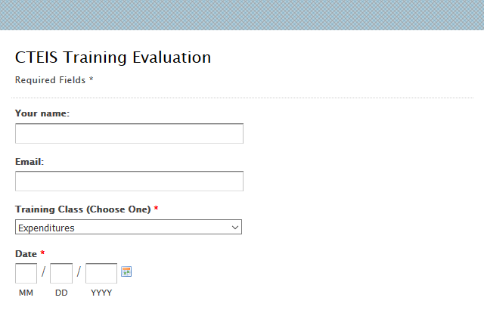
Questions?
Thank you!
Don’t forget to fill out our Training Evaluation Form at
support.cteis.com/Training/ Registration-General-Info

